Slide 1

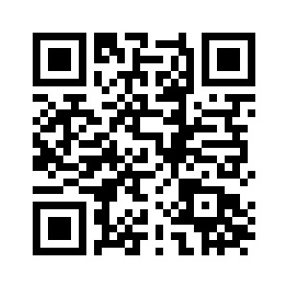



Project Title
Team ID -
CU_CP_Team_7467
Zishan vhora
Yash Dave
Kunal Chauhan

Slide 2

Project Objectives
Problem Statement
Project Overview – Introduction
End Users
Wow Factor in Project
Modelling/Block Diagram/Flow of Project
Result/outcomes
Conclusion
Future Perspective

Slide 3
Problem Statement
Navigating the job market efficiently remains a significant challenge for job seekers, especially in tech domains. Conventional job portals require users to manually sift through job listings, often leading to inefficient searches. SkillMatch addresses these issues by:
Automating job recommendations based on the user's technical skills.
Providing a streamlined, data-driven approach to career planning.
Filtering out irrelevant roles, enhancing accuracy and usability.

Slide 4
Project overview - Introduction
SkillMatch is a web-based application designed to assist individuals in finding the most suitable tech jobs based on their skills. The system leverages machine learning algorithms to predict and display relevant job roles dynamically. Built using Streamlit, the app offers a modern UI with an intuitive user experience.
Key Features :
Skill Selection Interface: Users can input 3–8 skills via a dropdown menu.
Intelligent Job Matching: The Random Forest Classifier predicts the top 3 most relevant job roles.
Compact Job Cards: Jobs are displayed horizontally with role descriptions, required skills, and match percentages.

Slide 5
End User
SkillMatch caters to:
Job Seekers: Professionals in the tech industry looking for new roles.
Career Changers: Individuals transitioning into tech fields.
Students & Fresh Graduates: Entry-level applicants exploring job possibilitie

Slide 6
Wow Factor in Solution
What sets SkillMatch apart?
AI-Powered Precision: Uses a trained ML model to provide smart, skill-based
job matches.🎨 Dark-Themed UI with Interactive Features: Users get a sleek, intuitive interface with hover effects and a dynamic bar chart showcasing match percentages.

Slide 7
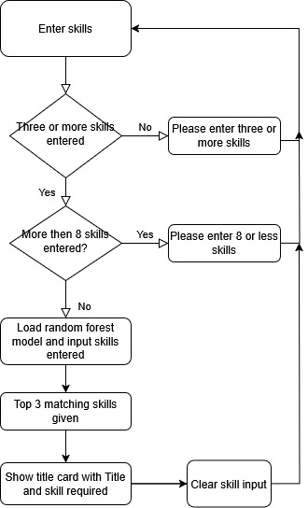
Modelling

Slide 8
Result / Outcomes
The SkillMatch system successfully delivers:
Highly Relevant Job Matches: Accurately recommends jobs based on skill sets.
Intuitive UI Design: A visually appealing and interactive job search experience.
Dynamic Visualization: Clear representation of job match percentages.
Scalability: The app is structured for future feature expansions.

Slide 9
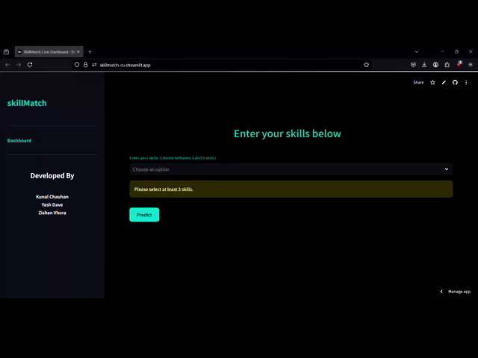

Slide 10
Conclusion
SkillMatch demonstrates how AI-driven job matching can transform career searches. The combination of machine learning and a user-friendly interface allows individuals to find roles tailored to their skills efficiently. The focus on job relevance, interactive UI elements, and data-driven recommendations makes SkillMatch a powerful tool for job seekers.

Slide 11
Future Perspective
Planned enhancements include:
Salary Estimation: Predicting salary ranges based on skills and experience
Skill Gap Analysis: Suggesting upskilling opportunities based on missing skills.
User Profiles: Enabling saved job preferences and past searches.
Mobile Optimization: Enhancing usability on smaller screens.
Improved ML Accuracy: Continuous refinement of prediction models with larger datasets.

Slide 12
Refernces :
https://youtube.com/playlist?list=PLgkF0qak9G4-TC9_tKW1V4GRcJ9cdmnlx&si=N3fHG7boDmjODVo3
https://www.youtube.com/live/YzvMpvXyUfs?si=SRe4K2Ze6gHPsfos
https://docs.streamlit.io/
https://youtu.be/MxiktOPmhV8?si=X36WTn9QvW5oNQQi
https://www.kaggle.com/datasets/riteshmn/naukri-jobs-data-mar-2023

Slide 13


Slide 14
Thank you...!
Notes:
14

